Slide 1

Resistor
All about.

Slide 2

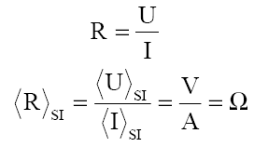
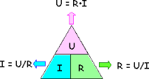
What is a resistor ?
The resistor is a component part of electronic and electrical circuits who has the principal propiety electrical resitance.
The most important parameter is the resistance of the resistor expressed in ohmi.

Slide 3

What does?
To produce power failure of voltage between two points in the circuit.
Fixing the current through another piece.
Division of voltage in a rapport who was gived (voltage divider circuit).
Ending a transmission line (load resistance).

Slide 4
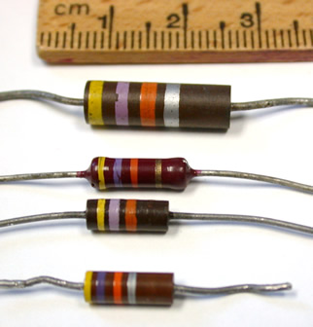
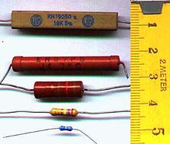
Marks
In practice we use two marks for resistor:
Obvious
Code of colors

Slide 5
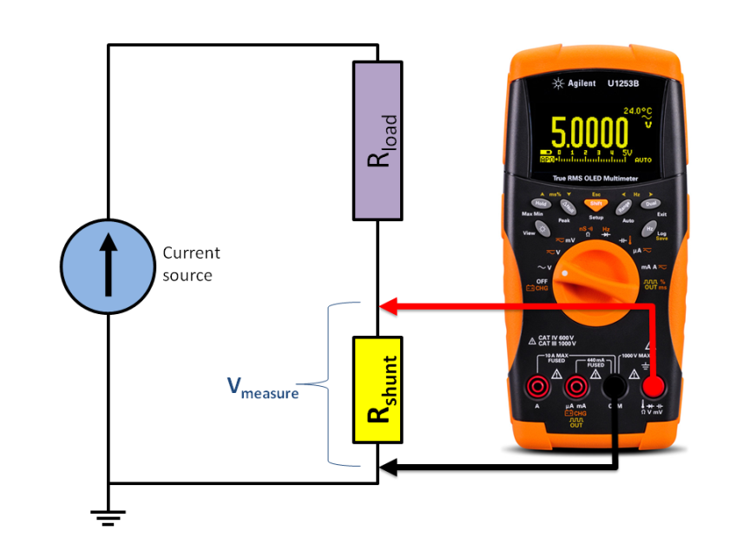
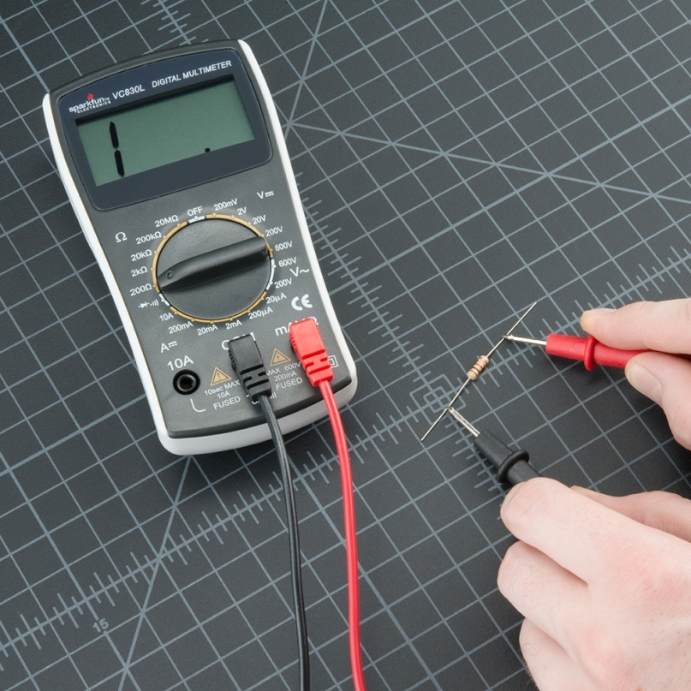
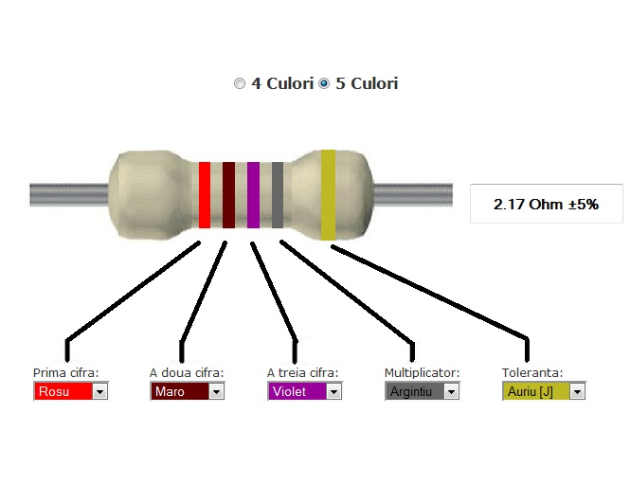
Value
Value of resistor can be determined by code of colors or use a multimeter.

Slide 6
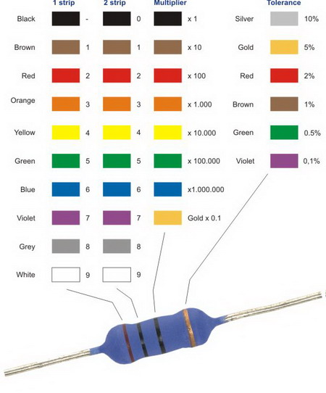
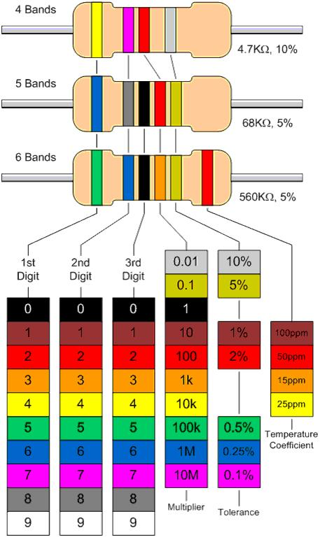

Slide 7
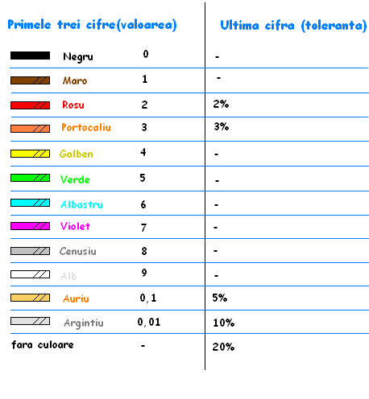
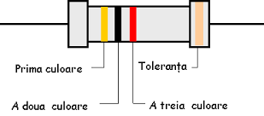
Tolerance
Each resistor has a specific tolerance based on the last color. The tolerance can be through 2%-20%.

Slide 8
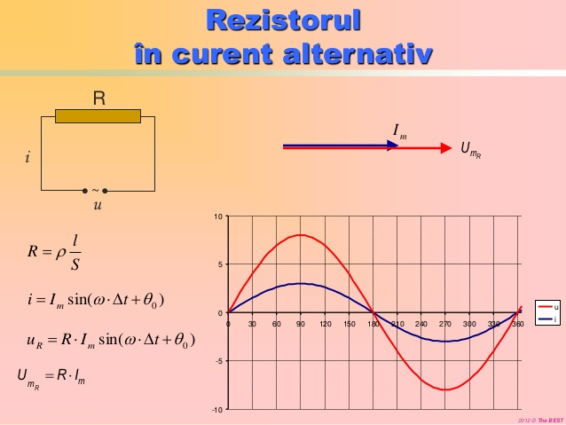
The power resistance of the resistor varies in alternating current, the measured current value, capacity and inductance due to the existence distributed along the length of the resistive element.

Slide 9
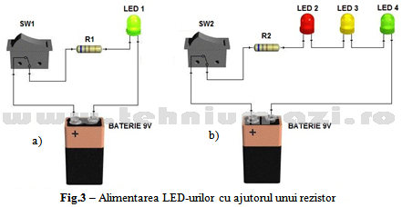
Schematic aplication

Slide 10
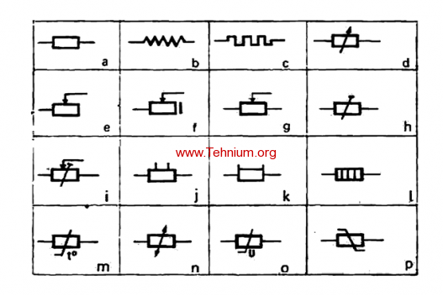
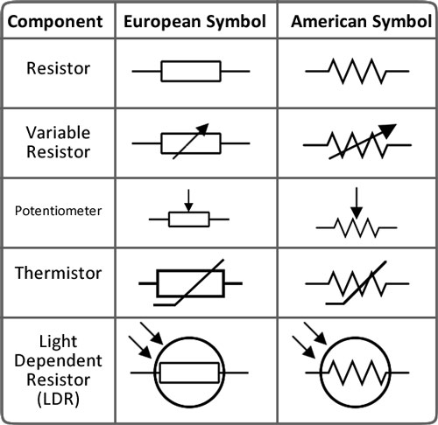
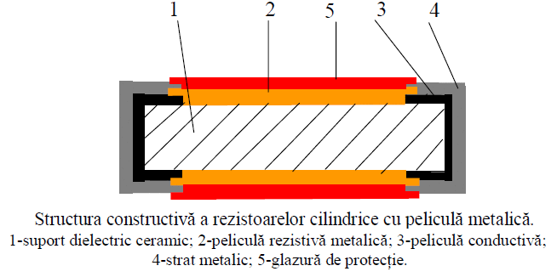
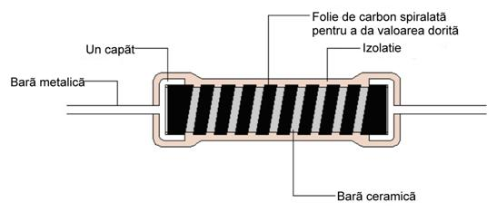
Simbol and structure

Slide 11

Game
http://www.engineering.com/Library/ArticlesPage/tabid/85/ArticleID/120/categoryId/8/Color-Code-for-Resistors.aspx

Slide 12
Source
http://electronicamicro.blogspot.ro/p/rezistorul-este-o-piesa-componenta-din.html
https://ro.wikipedia.org/wiki/Rezistor

Slide 13

Thank you !
Project created by: Suhăreanu Sandra Maria
Subject: Resistor

